Slide 1
Chapter 13 Abstract Classes and Interfaces
1

Slide 2
Abstract Classes
In inheritance, classes become more specific and concrete with each new subclass.
GeometricObject
Rectangle, Circle
If you move from a subclass back up to a superclass, the classes become more general and less specific.
2

Slide 3
Abstract Classes
Class design should ensure that a superclass contains common features of its subclasses.
Sometimes a superclass is so abstract that it cannot be used to create any specific instances.
Creating a GeometricObject ?
Such a class is referred to as an abstract class.
3

Slide 4
Abstract Classes
Both Circle and Rectangle contain the getArea() and getPerimeter() methods for computing the area and perimeter of a circle and a rectangle.
Since you can compute areas and perimeters for all geometric objects, it is better to define the getArea() and getPerimeter() methods in the GeometricObject class.
4

Slide 5
Abstract Classes
However, these methods cannot be implemented in the GeometricObject class, because their implementation depends on the specific type of geometric object.
Such methods are referred to as abstract methods and are denoted using the abstract modifier in the method header.
After you define the methods in GeometricObject, it becomes an abstract class. Abstract classes are denoted using the abstract modifier in the class header.
In UML graphic notation, the names of abstract classes and their abstract methods are italicized.
5

Slide 6
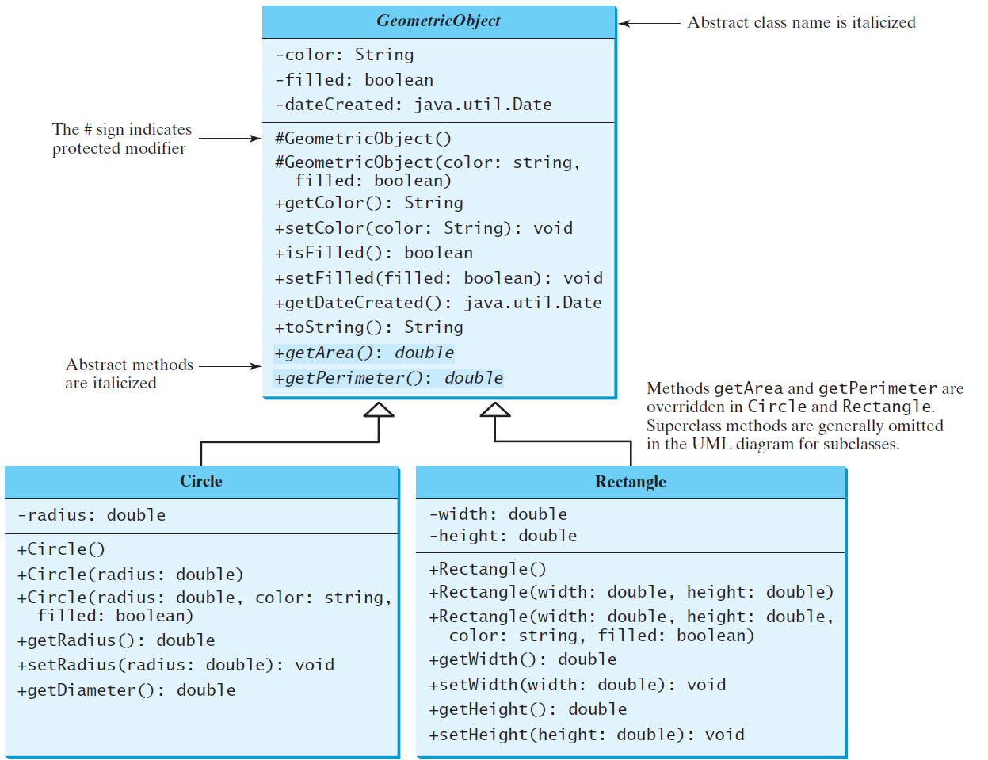
Abstract Classes and Abstract Methods
GeometricObject
Circle
Rectangle
TestGeometricObject
Run
6

Slide 7
abstract method in abstract class
An abstract method cannot be contained in a nonabstract class.
If a subclass of an abstract superclass does not implement all the abstract methods, the subclass must be defined abstract.
In other words, in a nonabstract subclass extended from an abstract class, all the abstract methods must be implemented, even if they are not used in the subclass.
7

Slide 8
object cannot be created from abstract class
An abstract class cannot be instantiated using the new operator.
We can still define its constructors, which are invoked in the constructors of its subclasses.
For instance, the constructors of GeometricObject are invoked in the Circle class and the Rectangle class.
8

Slide 9
abstract class without abstract method
A class that contains abstract methods must be abstract.
However, it is possible to define an abstract class that contains no abstract methods. In this case, you cannot create instances of the class using the new operator.
This class is used as a base class for defining a new subclass.
9

Slide 10
superclass of abstract class may be concrete
A subclass can be abstract even if its superclass is concrete.
For example, the Object class is concrete, but its subclasses, such as GeometricObject, may be abstract.
10

Slide 11
abstract class as type
You cannot create an instance from an abstract class using the new operator, but an abstract class can be used as a data type.
GeometricObject c = new Circle(2);
The following statement, which creates an array whose elements are of GeometricObject type, is correct.
GeometricObject[] geo = new GeometricObject[10];
11

Slide 12
Interesting Points about Abstract Classes
Abstract – Super/Subclass – Static
An abstract method cannot be contained in a nonabstract class.
If a subclass of an abstract superclass does not implement all the abstract methods, the subclass must be defined as abstract.
In other words, in a nonabstract subclass extended from an abstract class, all the abstract methods must be implemented.
Also note that abstract methods are nonstatic.
Instance – Constructors
An abstract class cannot be instantiated using the new operator,
but you can still define its constructors, which are invoked in the constructors of its subclasses.
For instance, the constructors of GeometricObject are invoked in the Circle class and the Rectangle class.
Abstract Class – Method
A class that contains abstract methods must be abstract.
However, it is possible to define an abstract class that does not contain any abstract methods.
In this case, you cannot create instances of the class using the new operator. This class is used as a base class for defining subclasses.

Slide 13
Interesting Points about Abstract Classes
Override
A subclass can override a method from its superclass to define it as abstract.
This is very unusual, but it is useful when the implementation of the method in the superclass becomes invalid in the subclass.
In this case, the subclass must be defined as abstract.
Abstract – Super/Subclasses
A subclass can be abstract even if its superclass is concrete.
For example, the Object class is concrete, but its subclasses, such as GeometricObject, may be abstract.
Instance – Data type
You cannot create an instance from an abstract class using the new operator, but an abstract class can be used as a data type.
Therefore, the following statement, which creates an array whose elements are of the GeometricObject type, is correct.
GeometricObject[] objects = new GeometricObject[10];
You can then create an instance of GeometricObject and assign its reference to the array like this:
objects[0] = new Circle();

Slide 14
☑ Check Point
Which of the following classes defines a legal abstract class?
(a) class A { abstract void unfinished() { } }
(b) public class abstract A { abstract void unfinished(); }
(c) class A { abstract void unfinished(); }
(d) abstract class A { protected void unfinished(); }
(e) abstract class A { abstract void unfinished(); }
(f) abstract class A { abstract int unfinished(); }
<--- ANSWER --->
a -> illegal
b -> illegal
c -> illegal
d -> illegal
e -> legal
f -> legal

Slide 15
☑ Check Point
The getArea() and getPerimeter() methods may be removed from the GeometricObject class. What are the benefits of defining getArea() and getPerimeter() as abstract methods in the GeometricObject class?
<--- ANSWER --->
The benefits are for generic programming. A variable of GeometricObject type can use the getArea and getPerimeter methods at compilation time.

Slide 16
☑ Check Point
True or false?
a. An abstract class can be used just like a nonabstract class except that you cannot use the new operator to create an instance from the abstract class.
b. An abstract class can be extended.
c. A subclass of a nonabstract superclass cannot be abstract.
d. A subclass cannot override a concrete method in a superclass to define it as abstract.
e. An abstract method must be nonstatic.
<--- ANSWER --->
a. True
b. True
c. False
d. False
e. True

Slide 17
☑ Check Point
Why do the following two lines of code compile but cause a runtime error? Number numberRef = new Integer(0); Double doubleRef = (Double)numberRef;
Why do the following two lines of code compile but cause a runtime error? Number[] numberArray = new Integer[2]; numberArray[0] = new Double(1.5);
<--- ANSWER --->
At runtime, JVM attempts to convert numberRef to a Double object, but numberRef is an instance of Integer, not Double.
numberArray[0] is of the Integer type. It will be a casting error at runtime.

Slide 18
☑ Check Point
Show the output of the following code. public class Test { public static void main(String[] args) { Number x = 3; System.out.println(x.intValue()); System.out.println(x.doubleValue()); } }
<--- ANSWER --->
3 3.0

Slide 19
☑ Check Point
What is wrong in the following code? (Note that the compareTo method for the Integer and Double classes was introduced in Section 10.7.) public class Test { public static void main(String[] args) { Number x = new Integer(3); System.out.println(x.intValue()); System.out.println(x.compareTo(new Integer(4))); } }
What is wrong in the following code? public class Test { public static void main(String[] args) { Number x = new Integer(3); System.out.println(x.intValue()); System.out.println((Integer)x.compareTo(new Integer(4))); } }
<--- ANSWER --->
The program has a syntax error because x does not have the compareTo method.
The program has a syntax error because the member access operator (.) is executed before the casting operator.

Slide 20
☑ Check Point
Can you create a Calendar object using the Calendar class?
Which method in the Calendar class is abstract?
How do you create a Calendar object for the current time?
For a Calendar object c, how do you get its year, month, date, hour, minute, and second?
<--- ANSWER --->
No. Calendar is an abstract class.
The add method in the Calendar class is abstract.
Use the GregorianCalendar class's no-arg constructor, you can create an instance of Calendar.
c.get(Calendar.YEAR) c.get(Calendar.MONTH) c.get(Calendar.DAY_OF_MONTH) c.get(Calendar.HOUR) c.get(Calendar.MINUTE) c.get(Calendar.SECOND)

Slide 21
*Case Study: Payroll System Using Polymorphism
A company pays its employees on a weekly basis.
The employees are of four types:
Salaried employees are paid a fixed weekly salary regardless of the number of hours worked,
Hourly employees are paid by the hour and receive overtime pay (i.e., 1.5 times their hourly salary rate) for all hours worked in excess of 40 hours,
Commission employees are paid a percentage of their sales and
Base-salaried commission employees receive a base salary plus a percentage of their sales.
For the current pay period, the company has decided to reward salaried-commission employees by adding 10% to their base salaries. The company wants to write an application that performs its payroll calculations polymorphically.
*Java : How To Program P.J. Deitel, H.M. Deitel., 9th ed.
21

Slide 22
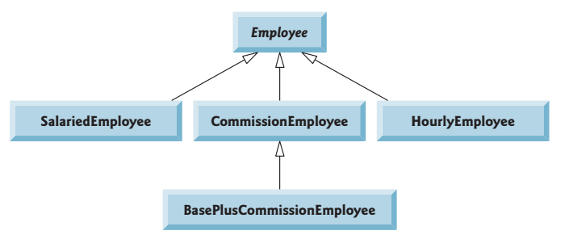
*Case Study: Payroll System Using Polymorphism
*Java : How To Program P.J. Deitel, H.M. Deitel., 9th ed.
22

Slide 23
Abstract Superclass Employee
a constructor that takes the first name, last name and social security number as arguments
get/set methods
Method toString()
abstract method earnings
23

Slide 24
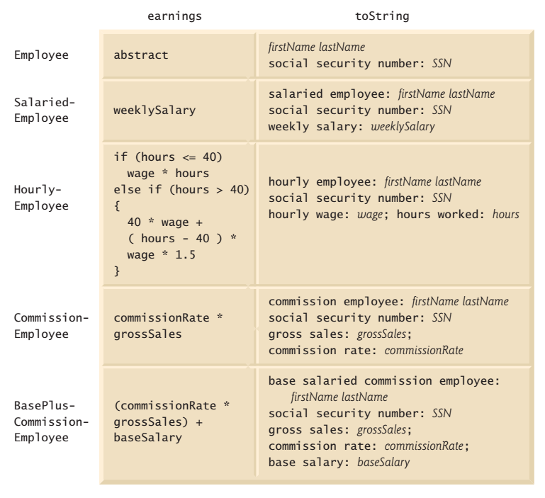
earnings and toString methods in class hierarchy

Slide 25
Concrete Subclass SalariedEmployee
SalariedEmployee extends class Employee
constructor that takes a first name, a last name, a social security number and a weekly salary as arguments
get/set methods
Method toString()
Method earnings
25

Slide 26
Concrete Subclass HourlyEmployee
HourlyEmployee extends class Employee
constructor that takes a first name, a last name, a social security number, an hourly wage and the number of hours worked.
get/set methods
Method toString()
Method earnings
26

Slide 27
Concrete Subclass CommissionEmployee
CommissionEmployee extends class Employee
constructor that takes a first name, a last name, a social security number, a sales amount and a commission rate;
get/set methods
Method toString()
Method earnings
27

Slide 28
Indirect Concrete Subclass BasePlusCommissionEmployee
BasePlusCommissionEmployee extends class CommissionEmployee
constructor that takes a first name, a last name, a social security number, a sales amount, a commission rate and a base salary.
get/set methods
Method toString()
Method earnings
28

Slide 29
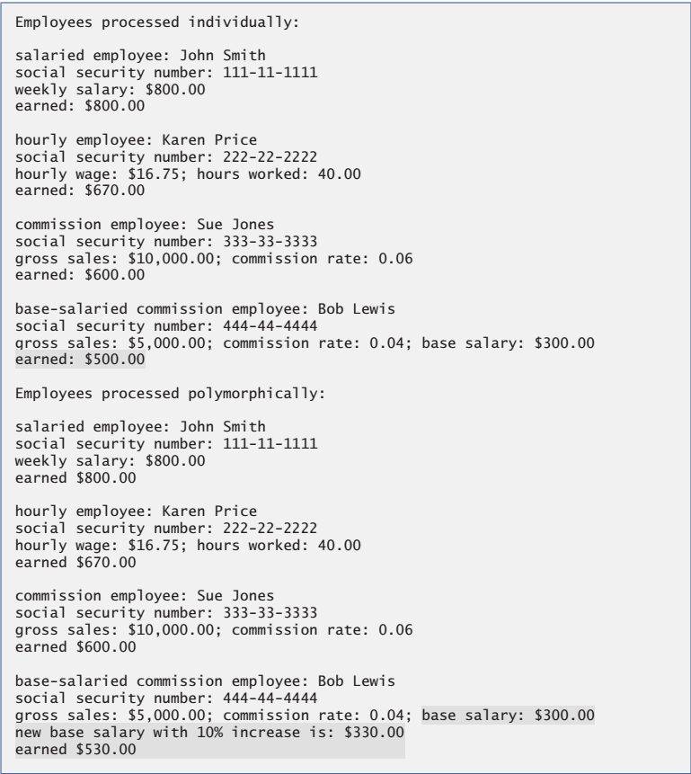
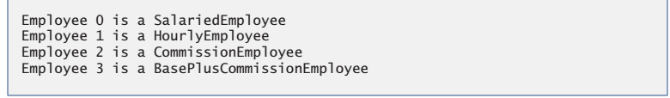
Sample Output:
29

Slide 30
Abstract Classes & Methods Review
What is an abstract method?
What is an abstract class?
Answer the following questions (True/False)?
An abstract class can be instantiated.
An abstract class must have at least one abstract method.
The subclasses of an abstract class must implement all the abstract methods defined in the superclass.
What happens if the subclass of an abstract class does not implement all the abstract methods?
A subclass of a concrete class cannot be abstract.
An abstract class cannot be used as a data type.
30

Slide 31
Interfaces
What is an interface?
Why is an interface useful?
How do you define an interface?
How do you use an interface?
31

Slide 32
What is an interface? Why is an interface useful?
An interface is a class-like construct that contains only constants and abstract methods.
In many ways, an interface is similar to an abstract class, but the intent of an interface is to specify common behavior for objects of related classes or unrelated classes.
For example, you can specify that the objects are comparable, edible, cloneable using appropriate interfaces.
32

Slide 33
Define an Interface
To distinguish an interface from a class, Java uses the following syntax to define an interface:
public interface InterfaceName {
constant declarations;
abstract method signatures;
}
Example:
public interface Edible {
/** Describe how to eat */
public abstract String howToEat();
}
33

Slide 34
Interface is a Special Class
An interface is treated like a special class in Java.
Each interface is compiled into a separate bytecode file, just like a regular class.
Like an abstract class, you cannot create an instance from an interface using the new operator.
You can use an interface as a data type for a variable, as the result of casting, and so on.
34

Slide 35
Example
You can now use the Edible interface to specify whether an object is edible.
This is accomplished by letting the class for the object implement this interface using the implements keyword.
For example, the classes Chicken and Fruit implement the Edible interface (See TestEdible).
class Fruit implements Edible
35

Slide 36
Omitting Modifiers in Interfaces
All data fields are public final static in an interface.
All methods are public abstract in an interface.
For this reason, these modifiers can be omitted, as shown below:
A constant defined in an interface can be accessed using syntax InterfaceName.CONSTANT_NAME (e.g., T1.K).
36

Slide 37
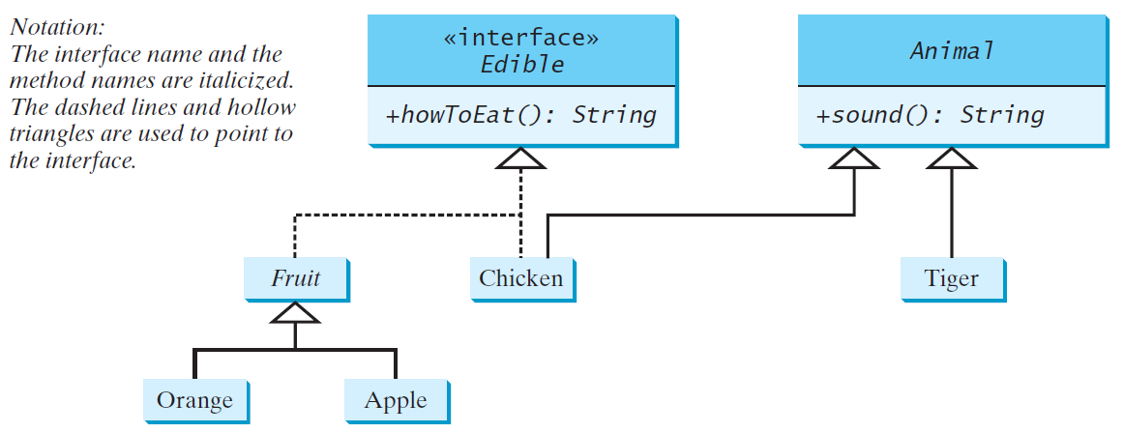
Example
Edible
TestEdible
Run
37

Slide 38
☑ Check Point
Suppose A is an interface. Can you create an instance using new A()?
Suppose A is an interface. Can you declare a reference variable x with type A like this? A x;
<--- ANSWER --->
No
Yes

Slide 39
☑ Check Point
Which of the following is a correct interface?
(a) interface A { void print() { } }
(b) abstract interface A { abstract void print() { } }
(c) abstract interface A { print(); }
(d) interface A { void print(); }
(e) interface A { default void print() { } }
(f) interface A { static int get() { return 0; } }
<--- ANSWER --->
(a) is wrong, because the print() method has a body.
(b) is wrong, because the interface cannot have the abstract keyword.
(c) is wrong, because the interface cannot have the abstract keyword.
(d) is correct.
(e) is correct. JDK 8 allows default methods in the interface.
(f) is correct. JDK 8 allows static methods in the interface.

Slide 40
☑ Check Point
Show the error in the following code: interface A { void m1(); } class B implements A { void m1() { System.out.println("m1"); } }
<--- ANSWER --->
All methods defined in an interface are public. When a class implements the interface, the method must be declared public. The visibility cannot be reduced.

Slide 41
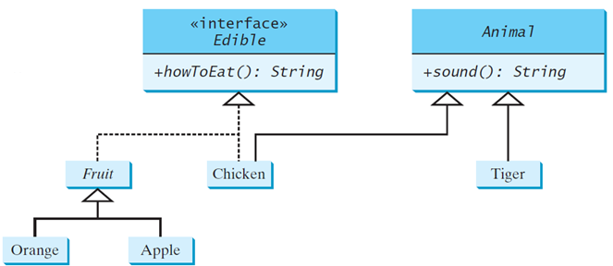
☑ Check Point
The following questions are based on the Edible interface and the classes defined in Listing 13.7 and also assume LittleChicken is a subtype of Chicken. For each question, answer if the code can compile, can run. If not, give a reason. If it runs, give the output.
a. Edible x = new Tiger();
b. Edible x = new Chicken(); System.out.println(x.sound());
c. Edible x = new Chicken(); System.out.println((Animal)x.sound());
d. Edible x = new Chicken(); System.out.println(((Animal)x).sound());
e. Edible x = new LittleChicken(); System.out.println(x.howToEat());
f. LittleChicken x = new Chicken();
<--- ANSWER --->
a. Compile error. Tiger is not Edible.
b. Compile error. x is declared Edible, but Edible does not have the sound() method.
c. Compile error. x.sound() performed first before casting. x does not have the sound() method.
d. Chicken: cock-a-doodle-doo
e. Chicken: Fry it
f. Compile error. Chicken is not a LittleChicken. Cannot assign a Chicken object to a variable of type LittleChicken.

Slide 42
The Comparable Interface
The Comparable interface defines the compareTo method for comparing objects.
// This interface is defined in java.lang package
package java.lang;
public interface Comparable<E> {
public int compareTo(E o);
}
42
Notes:
- Suppose you want to design a generic method to find the larger of two objects of the same type, such as two students, two dates, two circles, two rectangles, or two squares.
- In order to accomplish this, the two objects must be comparable, so the common behavior for the objects must be comparable.

Slide 43
The Comparable Interface
public interface Comparable<E> { public int compareTo(E o);
}
The Comparable interface is a generic interface.
The generic type E is replaced by a concrete type when implementing this interface.
43

Slide 44
Integer and BigInteger Classes
String and Date Classes
44

Slide 45
Example
Use the compareTo method to compare two numbers, two strings, and two dates. For example, the following code
1 System.out.println(new Integer(3).compareTo(new Integer(5)));
2 System.out.println("ABC".compareTo("ABE"));
3 java.util.Date date1 = new java.util.Date(2013, 1, 1);
4 java.util.Date date2 = new java.util.Date(2012, 1, 1);
5 System.out.println(date1.compareTo(date2));
displays -1 // 3 is less then 5 -2 // ABC is less than ABE 1 // date1 is greater than date2.
45

Slide 46
Generic sort Method
Let n be an Integer object, s be a String object, and d be a Date object. All the following expressions are true.
The java.util.Arrays.sort(array) method requires that the elements in an array are instances of Comparable<E>.
46

Slide 47
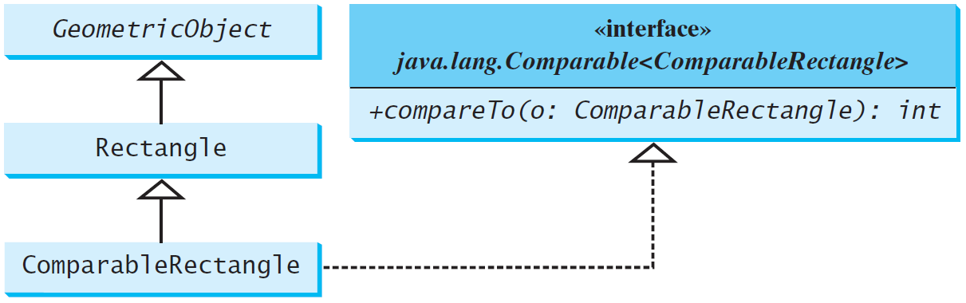
Defining Classes to Implement Comparable
ComparableRectangle
SortRectangles
Run
47
Notes:
47
You cannot use the sort method to sort an array of Rectangle objects, because Rectangle does not implement Comparable. However, you can define a new rectangle class that implements Comparable. The instances of this new class are comparable.

Slide 48
☑ Check Point
True or false? If a class implements Comparable, the object of the class can invoke the compareTo method.
Which of the following is the correct method header for the compareTo method in the String class? public int compareTo(String o) public int compareTo(Object o)
Can the following code be compiled? Why? Integer n1 = new Integer(3); Object n2 = new Integer(4); System.out.println(n1.compareTo(n2));
You can define the compareTo method in a class without implementing the Comparable interface. What are the benefits of implementing the Comparable interface?
<--- ANSWER --->
True
The first one is correct.
n1 is an Integer object whose compareTo method require an Integer argument, but n2 is declared as Object. The compiler will raise an error.
By implementing the Comparable interface, the object of the class can be passed to a method that requires a Comparable type.

Slide 49
☑ Check Point
What is wrong in the following code? public class Test { public static void main(String[] args) { Person[] persons = {new Person(3), new Person(4), new Person(1)}; java.util.Arrays.sort(persons); } } class Person { private int id; Person(int id) { this.id = id; } }
<--- ANSWER --->
The Person class does not implement the Comparable interface, two persons cannot be compared using the compareTo method.

Slide 50
☑ Check Point
1 public class ComparableRectangle extends Rectangle
2 implements Comparable<ComparableRectangle> {
3 /** Construct a ComparableRectangle with specified properties */
4 public ComparableRectangle(double width, double height) {
5 super(width, height);
6 }
7
8 @Override // Implement the compareTo method defined in Comparable
9 public int compareTo(ComparableRectangle o) {
10 if (getArea() > o.getArea())
11 return 1;
12 else if (getArea() < o.getArea())
13 return -1;
14 else
15 return 0;
16 }
17
18 @Override // Implement the toString method in GeometricObject
19 public String toString() {
20 return super.toString() + " Area: " + getArea();
21 }
22 }
Simplify the code in lines 10-15 using one line of code. Also override the equals method in this class.
<--- ANSWER --->
return getArea() > o.getArea() ? 1 : (getArea() < o.getArea() ? -1 : 0); The equals method can be overridden as follows: @Override public boolean equals(Object o) { return getArea() == ((CompareRectangle)o).getArea(); }

Slide 51
☑ Check Point
1 import java.util.ArrayList;
2 import java.math.*;
3
4 public class LargestNumbers {
5 public static void main(String[] args) {
6 ArrayList<Number> list = new ArrayList<>();
7 list.add(45); // Add an integer
8 list.add(3445.53); // Add a double
9 // Add a BigInteger
10 list.add(new BigInteger("3432323234344343101"));
11 // Add a BigDecimal
12 list.add(new BigDecimal("2.0909090989091343433344343"));
13
14 System.out.println("The largest number is " +
15 getLargestNumber(list));
16 }
17
18 public static Number getLargestNumber(ArrayList<Number> list) {
19 if (list == null || list.size() == 0)
20 return null;
21
22 Number number = list.get(0);
23 for (int i = 1; i < list.size(); i++)
24 if (number.doubleValue() < list.get(i).doubleValue())
25 number = list.get(i);
26
27 return number;
28 }
29 }
The code has an error. If you add list.add(new BigInteger("3432323234344343102")); in line 11, you will see that the result is incorrect. This is due to the fact that a double value can have up to 17 significant digits. When invoking doubleValue() on a BigInteger object in line 24, precision is lost. Fix the error by converting the numbers into BigDecimal and compare them using the compareTo method in line 24.
<--- ANSWER --->
if (new BigDecimal(number + "").compareTo (new BigDecimal(list.get(i) + "")) < 0) { The complete code is here: import java.util.ArrayList; import java.math.*; public class LargestNumber { public static void main(String[] args) { ArrayList<Number> list = new ArrayList<>(); list.add(45); // Add an integer list.add(3445.53); // Add a double // Add a BigInteger list.add(new BigInteger("3432323234344343101")); list.add(new BigInteger("3432323234344343102")); // Add a BigDecimal list.add(new BigDecimal("2.0909090989091343433344343")); System.out.println("The largest number is " + getLargestNumber(list)); } public static Number getLargestNumber(ArrayList<Number> list) { if (list == null || list.size() == 0) return null; Number number = list.get(0); for (int i = 1; i < list.size(); i++) if (new BigDecimal(number + "").compareTo (new BigDecimal(list.get(i) + "")) < 0) { number = list.get(i); } return number; } }

Slide 52
The Cloneable Interfaces
The Cloneable interface specifies that an object can be cloned.
Marker Interface: An empty interface.
A marker interface does not contain constants or methods. It is used to denote that a class possesses certain desirable properties. A class that implements the Cloneable interface is marked cloneable, and its objects can be cloned using the clone() method defined in the Object class.
package java.lang;
public interface Cloneable {
}
52

Slide 53
Examples
int[] list1 = {1, 2};
int[] list2 = list1.clone();
list1[0] = 7;
list2[1] = 8;
System.out.println("list1 is " + list1[0] + ", " + list1[1]);
System.out.println("list2 is " + list2[0] + ", " + list2[1]);
displays
list1 is 7, 2
list2 is 1, 8
53
Notes:
53

Slide 54
Implementing Cloneable Interface
To define a custom class that implements the Cloneable interface, the class must override the clone() method in the Object class.
If we try to create a clone of an object instance of a class that does not implement the Cloneable interface, it throws CloneNotSupportedException.
54
Notes:
54

Slide 55
Implementing Cloneable Interface
We can override the clone() method from the Object class to create custom clones.
The clone method in the Object class creates a new instance of the class of this object and initializes all its fields with exactly the contents of the corresponding fields of this object, as if by assignment; the contents of the fields are not themselves cloned.
The clone method in the Object class has a protected modifier. To use this method in any package, the implementing class should change the visibility modifier to public.
The clone() method returns an Object that needs to be casted.
55
Notes:
55

Slide 56
Implementing Cloneable Interface
The following code defines a class named House that implements Cloneable and Comparable.
House
56
Notes:
56

Slide 57
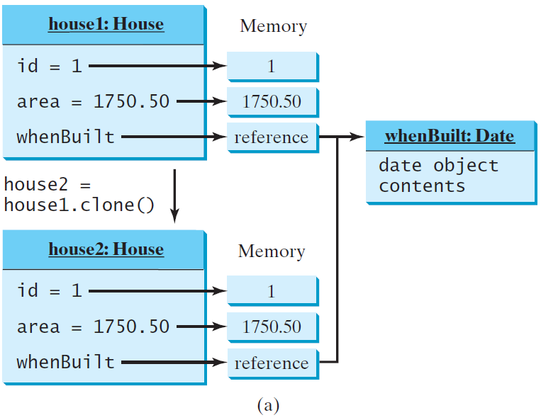
Shallow vs. Deep Copy
House house1 = new House(1, 1750.50);
House house2 = (House)house1.clone();
Shallow Copy
shallow copy: if the field is of reference type, the object’s reference is copied rather than its content.
57
Notes:
57

Slide 58
To perform a deep copy for a House object, replace the clone() method in lines 26–28 with the following code:
Deep Copy
public Object clone() { try { // Perform a shallow copy House houseClone = (House)super.clone(); // Deep copy on whenBuilt houseClone.whenBuilt = (java.util.Date)(whenBuilt.clone()); return houseClone; } catch (CloneNotSupportedException ex) { return null; } }
58
Notes:
58

Slide 59
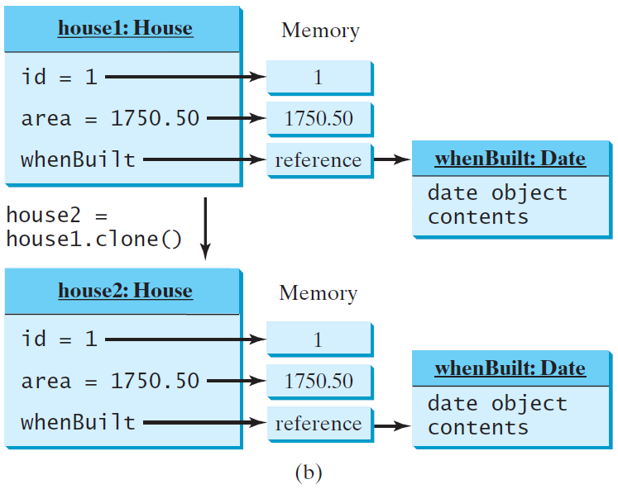
Shallow vs. Deep Copy
House house1 = new House(1, 1750.50);
House house2 = (House)house1.clone();
Deep Copy
59
Notes:
59

Slide 60
☑ Check Point
Can a class invoke super.clone() when implementing the clone() method if the class does not implement java.lang.Cloneable? Does the Date class implement Cloneable?
<--- ANSWER --->
You can invoke super.clone() when implementing the clone() method if the class does not implement java.lang.Cloneable, as shown below: class Foo { int x = 5; public Object clone() throws CloneNotSupportedException { return super.clone(); } } However, it does not actually clone the object. The following code will throw CloneNotSupportedException. public class Test1 { public static void main(String[] args) throws CloneNotSupportedException { Foo foo = (Foo)new Foo().clone(); System.out.println(foo.x); } } If the Foo class implements java.lang.Cloneable as follows, the Test1 class will run fine. class Foo implements java.lang.Cloneable { int x = 5; public Object clone() throws CloneNotSupportedException { return super.clone(); } } Yes, the Date class implements Cloneable.

Slide 61
☑ Check Point
What would happen if the House class (defined in Listing 13.11) did not override the clone() method or if House did not implement java.lang.Cloneable?
<--- ANSWER --->
If the House class does not override the clone() method, the program would receive a syntax error because clone() is protected in java.lang.Object. For example, the following code cannot compile. public class Test1 { public static void main(String[] args) throws CloneNotSupportedException { House house = (House)new House().clone(); // clone() is not visible } } If House does not implement java.lang.Cloneable, a CloneNotSupportedException would occur when invoking super.clone().

Slide 62
☑ Check Point
Show the output of the following code: java.util.Date date = new java.util.Date(); java.util.Date date1 = date; java.util.Date date2 = (java.util.Date)(date.clone()); System.out.println(date == date1); System.out.println(date == date2); System.out.println(date.equals(date2));
<--- ANSWER --->
true
false
true

Slide 63
☑ Check Point
Show the output of the following code: ArrayList<String> list = new ArrayList<>(); list.add("New York"); ArrayList<String> list1 = list; ArrayList<String> list2 = (ArrayList<String>)(list.clone()); list.add("Atlanta"); System.out.println(list == list1); System.out.println(list == list2); System.out.println("list is " + list); System.out.println("list1 is " + list1); System.out.println("list2.get(0) is " + list2.get(0)); System.out.println("list2.size() is " + list2.size());
<--- ANSWER --->
true false list is [New York, Atlanta] list1 is [New York, Atlanta] list2.get(0) is New York list2.size() is 1

Slide 64
☑ Check Point
(a) What is wrong in the following code? public class Test { public static void main(String[] args) { GeometricObject x = new Circle(3); GeometricObject y = x.clone(); System.out.println(x == y); } }
(b) Why does the following code have no compile errors? public class Test5 { public static void main(String[] args) throws CloneNotSupportedException { Test5 x = new Test5(); GeometricObject y = (GeometricObject)x.clone(); } }
<--- ANSWER --->
In (a), a compile error is reported because clone() is protected in Object. To enable cloning, do two things: (1) override clone() in the class for the object to be cloned; (2) implement java.lang.Cloneable for the class.
In (b), no compile errors, because Test5 extends Object and the clone() method is defined in the Object class, which is visible in Test5. However, when you run the code, a CloneNotSupportedException will be thrown, because the clone() method is not implemented in Test5 and Test5 does not implement the Cloneable interface.

Slide 65
☑ Check Point
Show the output of the following code. public class Test { public static void main(String[] args) { House house1 = new House(1, 1750, 50); House house2 = (House)house1.clone(); System.out.println(house1.equals(house2); } }
<--- ANSWER --->
false

Slide 66
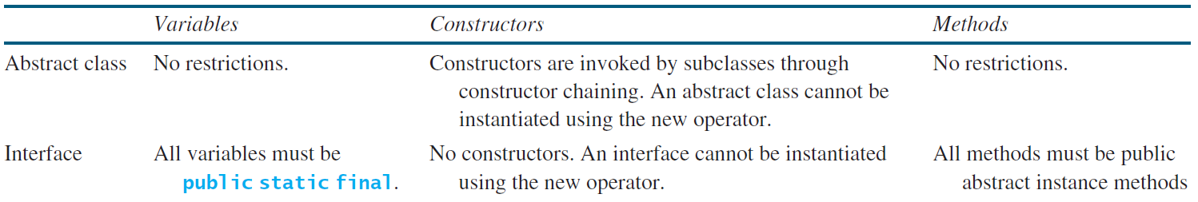
Interfaces vs. Abstract Classes
A class can implement multiple interfaces, but it can only extend one superclass.
In an interface, the data must be constants; an abstract class can have all types of data.
Each method in an interface has only a signature without implementation; an abstract class can have concrete methods.
66

Slide 67
Interfaces vs. Abstract Classes, cont.
All classes share a single root, the Object class, but there is no single root for interfaces.
Like a class, an interface also defines a type.
A variable of an interface type can reference any instance of the class that implements the interface.
You can use an interface as a data type and cast a variable of an interface type to its subclass, and vice versa.
An interface can inherit other interfaces (but not classes) using the extends keyword. Such an interface is called a subinterface.
If a class extends an interface, this interface plays the same role as a superclass.
67

Slide 68
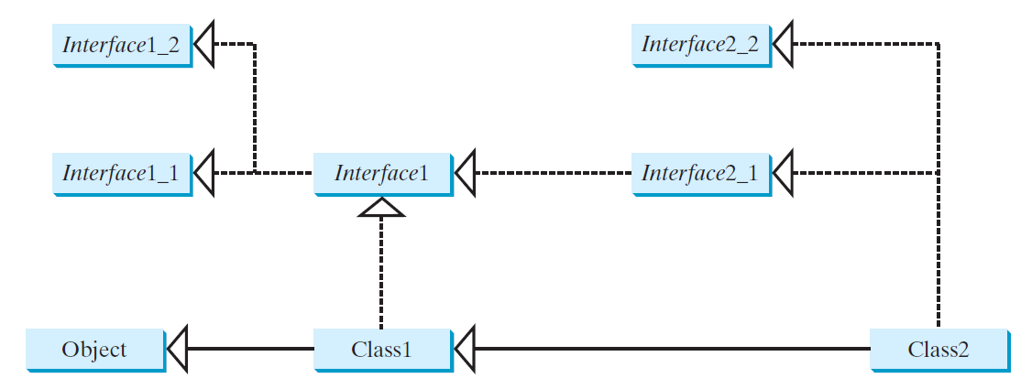
Interfaces vs. Abstract Classes, cont.
Suppose that c is an instance of Class2.
c is also an instance of Object, Class1, Interface1, Interface1_1, Interface1_2, Interface2_1, and Interface2_2.
A class implementing Interface2_1 must implement the abstract methods defined in Interface1, Interface1_1, and Interface1_2.
68

Slide 69
Caution: conflicting interfaces
Errors detected by the compiler:
If a class implements two interfaces with conflict information:
two same constants with different values,
or
two methods with same signature but different return type
69

Slide 70
Whether to use an interface or a class?
Abstract classes and interfaces can both be used to model common features.
How do you decide whether to use an interface or a class?
In general, a strong is-a relationship that clearly describes a parent-child relationship should be modeled using classes.
For example, a staff member is a person.
70

Slide 71
Whether to use an interface or a class?
A weak is-a relationship, also known as an is-kind-of relationship, indicates that an object possesses a certain property.
A weak is-a relationship can be modeled using interfaces.
For example, all strings are comparable, so the String class implements the Comparable interface.
You can also use interfaces to circumvent single inheritance restriction if multiple inheritance is desired.
71

Slide 72
☑ Check Point
Give an example to show why interfaces are preferred over abstract classes.
Define the terms abstract classes and interfaces. What are the similarities and differences between abstract classes and interfaces?
True or false?
a. An interface is compiled into a separate bytecode file.
b. An interface can have static methods.
c. An interface can extend one or more interfaces.
d. An interface can extend an abstract class.
e. An interface can have default methods.
<--- ANSWER --->
See the example in the text in the section on Interfaces vs. Abstract Classes.
See the section on Interfaces vs. Abstract Classes.
a. True
b. True in Java 8
c. True
d. False
e. True in Java 8

Slide 73
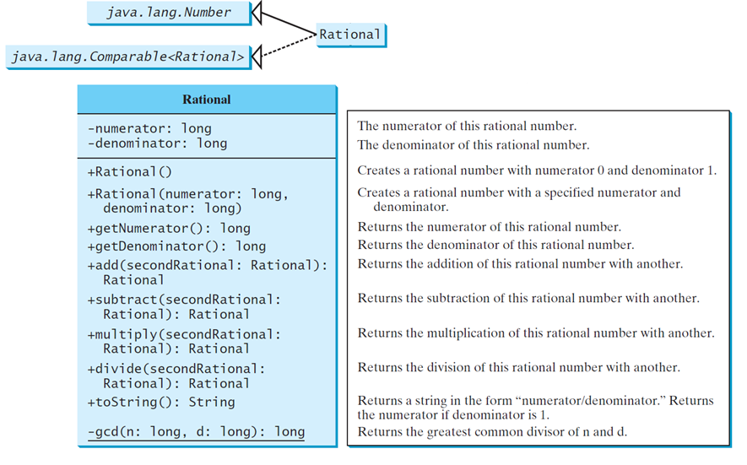
The Rational Class
Rational
TestRationalClass
Run
73

Slide 74
☑ Check Point
Show the output of the following code? Rational r1 = new Rational(-2, 6); System.out.println(r1.getNumerator()); System.out.println(r1.getDenominator()); System.out.println(r1.intValue()); System.out.println(r1.doubleValue());
Why is the following code wrong? Rational r1 = new Rational(-2, 6); Object r2 = new Rational(1, 45); System.out.println(r2.compareTo(r1));
<--- ANSWER --->
-1 3 0 0.333333333333
The Object type r2 does not have the compareTo method.

Slide 75
☑ Check Point
Why is the following code wrong? Object r1 = new Rational(-2, 6); Rational r2 = new Rational(1, 45); System.out.println(r2.compareTo(r1));
Simplify the code in lines 82-85 in Listing 13.13 Rational.java using one line of code without using the if statement. Simply the code in lines 110-115 using a conditional operator.
<--- ANSWER --->
The compareTo(Rational) method requires a Rational type object in the parameter in the Rational class.
public boolean equals(Object o) { return (this.subtract((Rational)(other))) .getNumerator() == 0; } public int compareTo(Rational o) { return this.subtract(o).getNumerator() > 0 ? 1 : (this.subtract(o).getNumerator() == 0 ? 0 : 1); }

Slide 76
☑ Check Point
Trace the program carefully and show the output of the following code. Rational r1 = new Rational(1, 2); Rational r2 = new Rational(1, -2); System.out.println(r1.add(r2));
The preceding question shows a bug in the toString method. Revise the toString() method to fix the error.
What happens if you create a Rational using new Rational(1, 0)? Discuss the appropriate ways for handling this case.
<--- ANSWER --->
0/4
public String toString() { if (numerator == 0 || denominator == 1) return numerator + ""; else return numerator + "/" + denominator; }
new Rational(1, 0) would create a Rational with denominator 0. The best way to handle this case is to throw an IllegalArgumentException when denominator is 0.

Slide 77
Class Design Guidelines
77

Slide 78
Coherence
A class should describe a single entity, and all the class operations should logically fit together to support a coherent purpose.
You can use a class for students, for example, but you should not combine students and staff in the same class, because students and staff have different entities.
Notes:
-You have learned how to design classes from the preceding two examples and from many other examples in the preceding chapters.
-This section summarizes some of the guidelines.

Slide 79
Coherence, cont.
A single entity with too many responsibilities can be broken into several classes to separate responsibilities.
The classes String, StringBuilder, and StringBuffer all deal with strings, for example, but have different responsibilities.
The String class deals with immutable strings, the StringBuilder class is for creating mutable strings, and the StringBuffer class is similar to StringBuilder except that StringBuffer contains synchronized methods for updating strings.

Slide 80
Consistency
Follow standard Java programming style and naming conventions.
Choose informative names for classes, data fields, and methods.
A popular style is to place the data declaration before the constructor and place constructors before methods.

Slide 81
Consistency, cont.
Always provide a constructor and initialize variables to avoid programming errors.
Provide a public no-arg constructor and override the equals method and the toString method defined in the Object class whenever possible.
In general, you should consistently provide a public no-arg constructor for constructing a default instance. If a class does not support a no-arg constructor, document the reason.

Slide 82
Reuse
Classes are designed for reuse.
Users can incorporate classes in many different combinations, orders, and environments.
Therefore, you should design a class that imposes no restrictions on what or when the user can do with it, design the properties to ensure that the user can set properties in any order, with any combination of values, and design methods to function independently of their order of occurrence.

Slide 83
Encapsulation
A class should use the private modifier to hide its data from direct access by clients. This makes the class easy to maintain.
Provide a getter method only if you want the data field to be readable, and provide a setter method only if you want the data field to be updateable.
A class should also hide methods not intended for client use. The gcd method in the Rational class is private, for example, because it is only for internal use within the class.

Slide 84
Using Visibility Modifiers
Each class can present two contracts – one for the users of the class and one for the extenders of the class.
Make the fields private and accessor methods public if they are intended for the users of the class.
Make the fields or method protected if they are intended for extenders of the class.

Slide 85
Using the static Modifier
A property that is shared by all the instances of the class should be declared as a static property.

